Slide 1
The W3C Linked Building Data Community Group
Chairs:
Kris McGlinn, Trinity College Dublin
Georg Ferdinand Schneider, Schaeffler Technologies AG & Co. KG
Maxime Lefrançois, MINES Saint-Étienne, France
Mads Holten Rasmussen, NIRAS

Slide 2
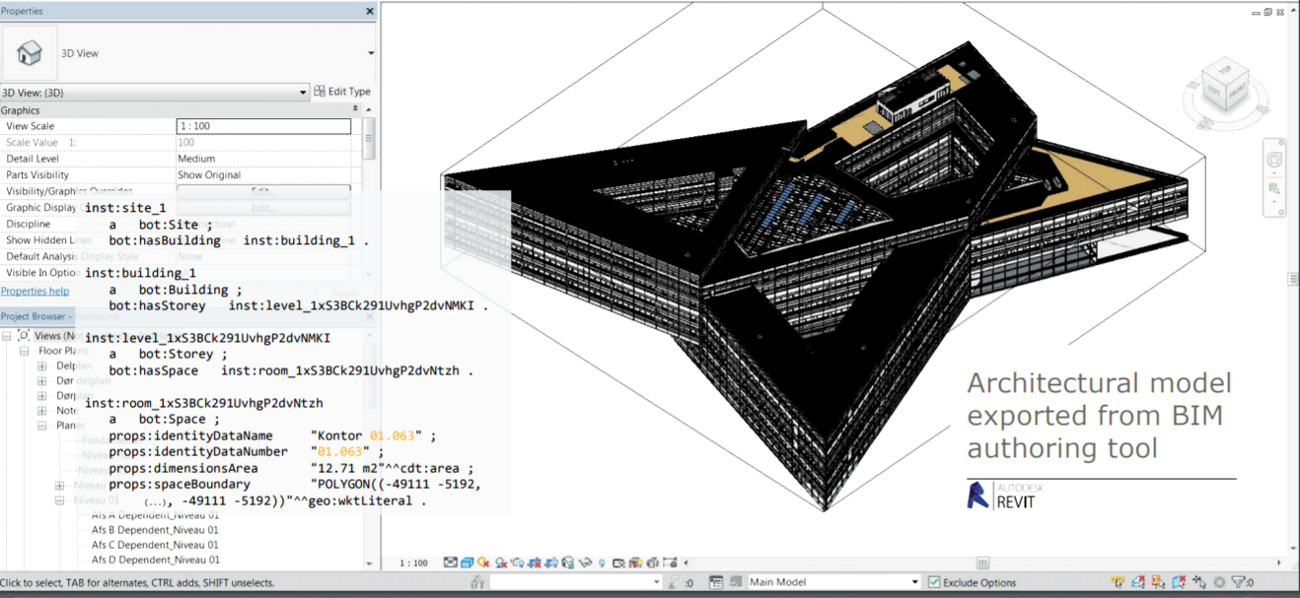
1
Building Information Modelling (BIM)
Notes:
1

Slide 3
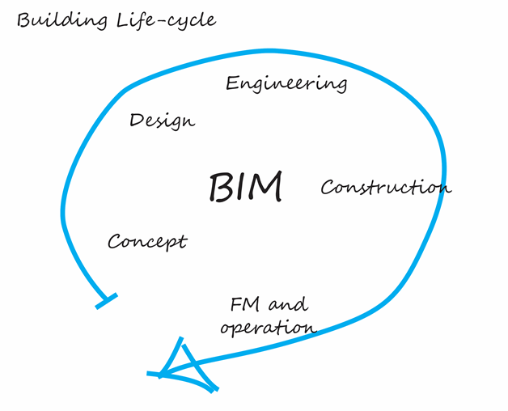
1
Building Life Cycle
Notes:
1

Slide 4
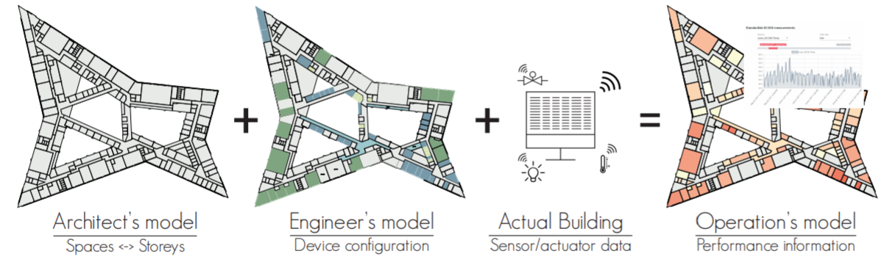
1
Building Life Cycle
Notes:
1

Slide 5
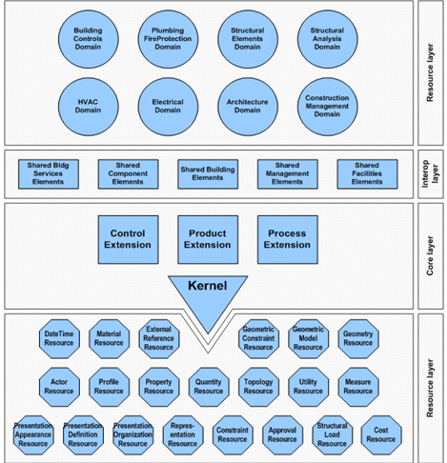
1
Industry Foundation Classes (IFC)
There exists a standard, but:
not modular
not extensible
not simple enough to use
AND not Web-compliant !
Notes:
1

Slide 6
OUTLINE
1
Who we are
What is our mission
What we produce
Where we head at (and who supports us)
Notes:
1

Slide 7
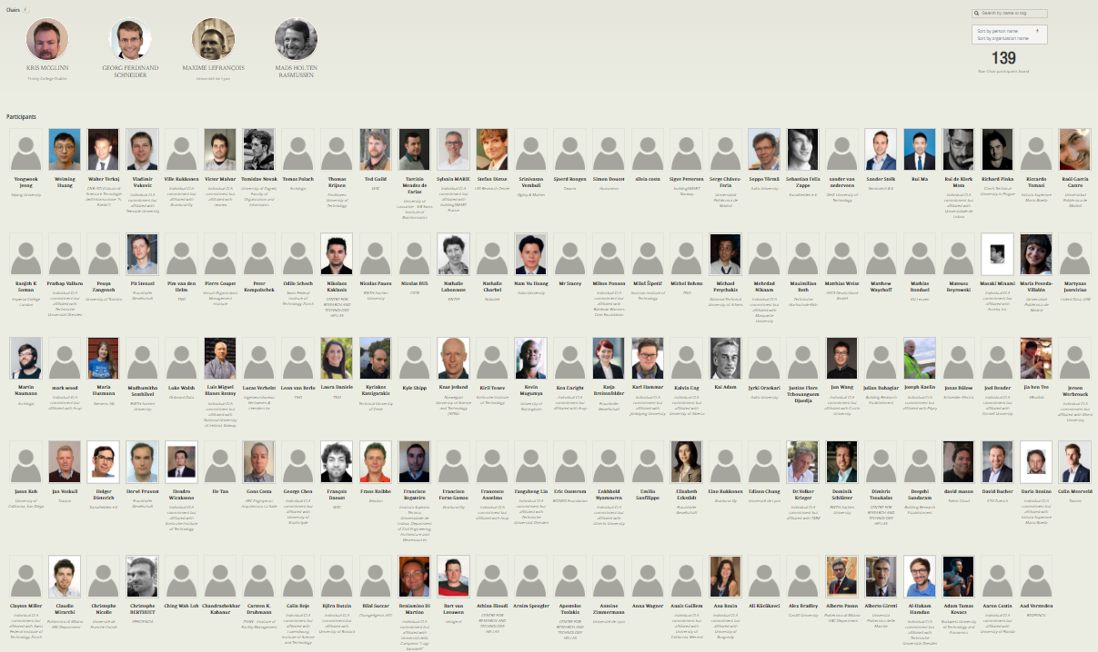
Who we are (2020)
started Dec. 2014 now 143 participants 18th biggest W3C CG
1
Notes:
1

Slide 8
How we work
1
Public mailing list
Regular online calls (every 2 weeks), minutes public, joint note-taking
Public GitHub organisation https://github.com/w3c-lbd-cg
Laisons with other groups and initiatives : BuildingSMART, ETSI SmartM2M, OGC, AFNOR, CEN, ISO, RealEstateCore, AIOTI WG3, ASHRAE 223 Semantic Interoperability, Brick Schema, AACE International, German expert groups "BIM und Holzbau" ("BIM and wood") and "Stahlbauforum" ("Steel construction")
W3C entrypoint: https://www.w3.org/community/lbd/
Group entrypoint: https://w3c-lbd-cg.github.io/lbd
Notes:
1

Slide 9
WHAT IS OUR MISSION
1
Bring together experts in the area of Building Information Modeling (BIM), who are working to address the challenge of managing the huge amount of data that is generated across the building life cycle.
We want to provide a forum for bringing together researchers and practitioners who are working on advancing the field.
Notes:
1

Slide 10
life cycle of a building
1
Vast amounts of heterogeneous around the life cycle of a building:
- product data (building elements)
- sensor measurements data
- usage data
- intelligent domotic system data
- geographical data, weather data, ...
Notes:
1

Slide 11
industrial point of view
1
Interesting oppotunities for industry from Linked Data and Knowledge Graph technologies :
- indoor navigation
- energy efficiency simulation
- web-based facility management
- and many more (cf. prop-tech)

Slide 12
The 4 principles of Linked Data … adapted to building data
1
Using URIs as names for building-related things such as: rooms, walls, products, elements, enable different parties to provide complementary descriptions of the same uniquely identified entities in different knowledge graphs.
Using HTTP URIs for these things enables the authority responsible for these URIs to provide reference information about this entity when one looks it up on the Web. For example, products in a catalogue, building appliances, or even the building itself.
Providing information using common standards (RDF, SPARQL) and common Knowledge Graph models enable semantic interoperability between data sources.
Include links to other URIs can help to discover more things, such as a link to the catalogue an appliance has been chosen from, or a link to the Web of Things Servient that enables it to interact with this appliance.

Slide 13
WHAT WE PRODUCE
Some of us push their work in the group

Slide 14
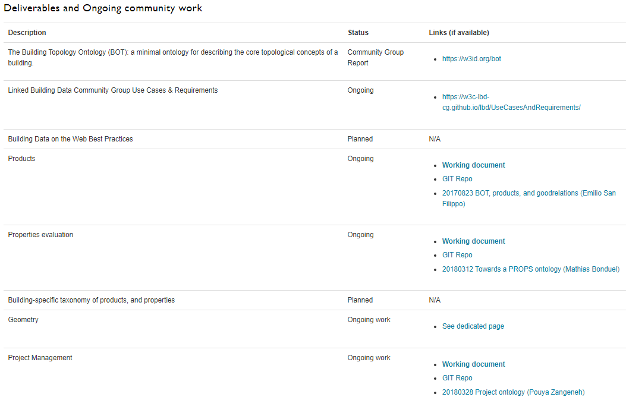
(From https://w3c-lbd-cg.github.io/lbd/ )
1

Slide 15
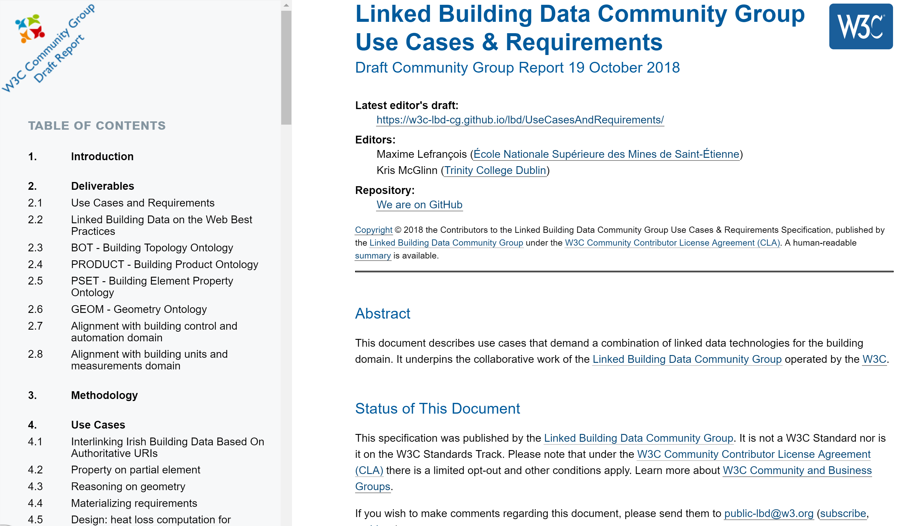
1
overview of the structure of the document
(at https://w3c-lbd-cg.github.io/lbd/UseCasesAndRequirements/ )
Comprehensive use case gathering is conducted across the LBD community, and also wider research and industrial communities (as part of the h2020 SWIMing project)
Used to identify deliverables and their scope in the charter
Currently 54 use cases, 7 requirements

Slide 16

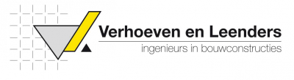










Use cases in practice
1
Further to these use cases, we strongly support and encourage active practitioners to perform reference implementations and active tests.
Notes:
1

Slide 17
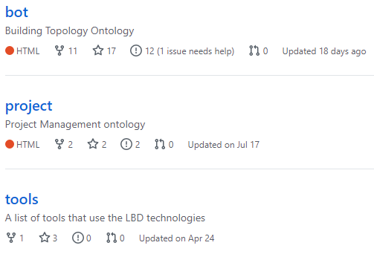
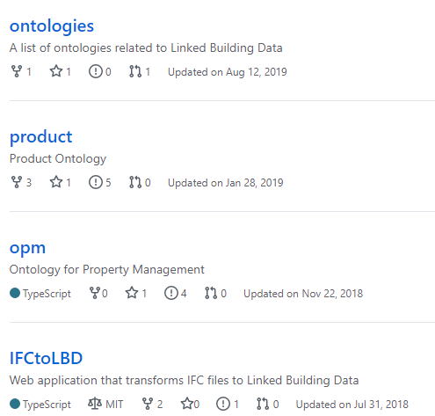
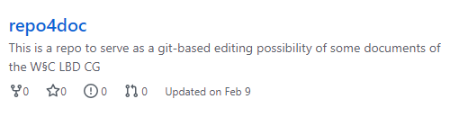
Other repositories
1
Notes:
1

Slide 18
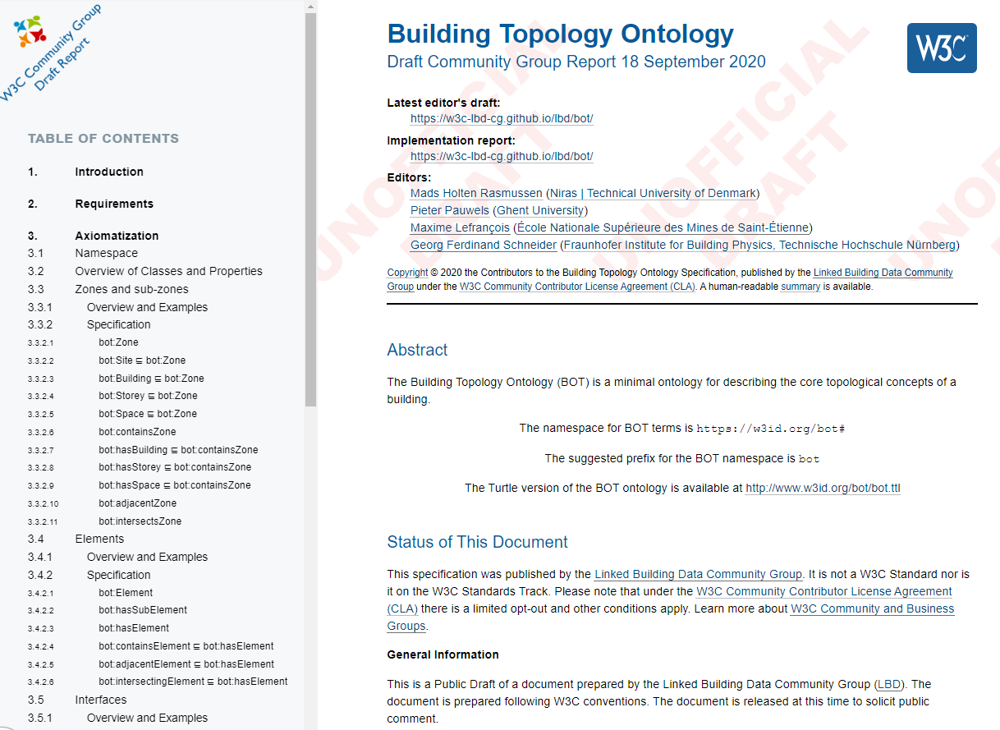
BUILDING TOPOLOGY ONTOLOGY
1
overview of the structure of the document (at https://w3id.org/bot/ )
Mads Holten Rasmussen, Maxime Lefrançois, Georg Ferdinand Schneider, Pieter Pauwels (2020). BOT: the Building Topology Ontology of the W3C Linked Building Data Group, Semantic Web Journal, IOS Press

Slide 19
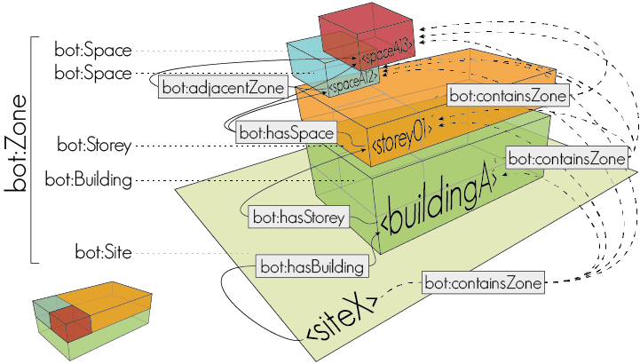
Building topology ontology
1

Slide 20
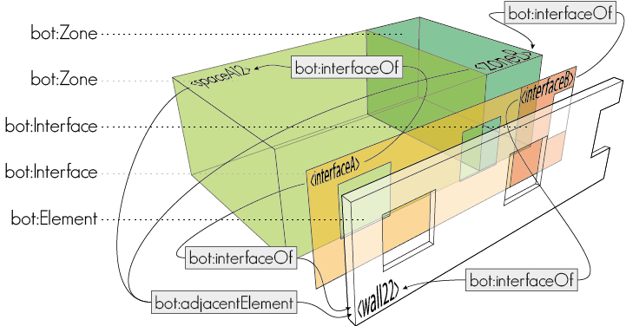
Building topology ontology
1

Slide 21
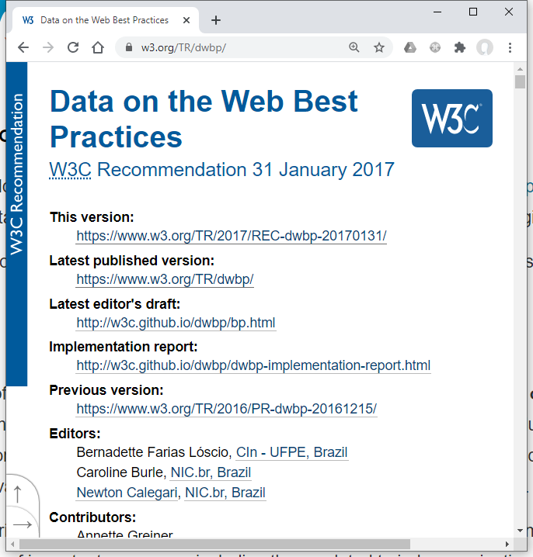
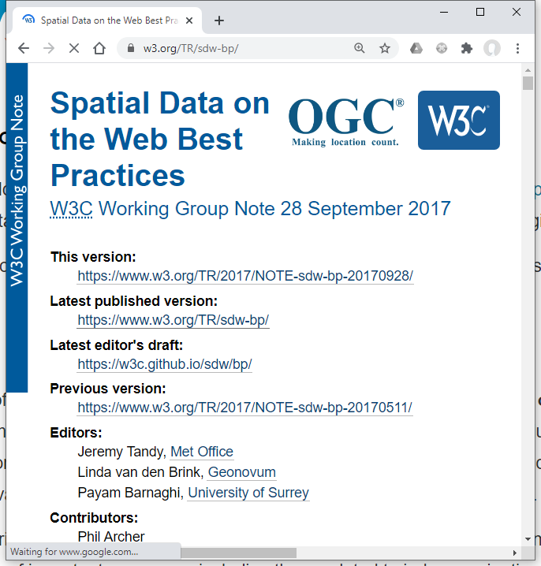
Other documents?
1
… (?)
Notes:
1

Slide 22
Alignments and Links
We don't use the close world assumption ;-)

Slide 23




Existing Vocabularies/Standards for Building Data
1
W3C | buildingSmart International | OGC | ISO | Other
SSN (Semantic Sensor Networks) | ifcOWL | GML (Geography Markup Language) -> ISO 19136:2015 | Data structures for electronic product catalogues for building services -- Part 1: Concepts, architecture and model (ISO 16757-1:2015) | DogONT (Ontology Modeling for Intelligent Domotic Environments)
owl-time | ISO 29481 Building information models -- Information delivery manual (IDM) | CityGML | Geographic Information - Spatial Schema (ISO 19107:2003) | SAREF (Smart Applications REFerence Ontology)
JSON-LD (JavaScript Object Notation for Linked Data) | ISO 12006 Building construction -- Organization of information about construction works | CityGML Building Module | OWL representation of part of the model for geometry and space from ISO 19107:2003 (ISO 19150-2) | Ontology of Spatial Relations (defined by the UK Ordnance Survey)
BasicGeo | ISO 12006-2 Framework for classification | GeoSPARQL |  | GeoVocab Geometry and Spatial Ontology
SOSA (Sensor, Observation, Sample, and Actuator) ontology | ISO 12006-3 Framework for object-oriented information (IFD) | Indoor GML |  | SmartEnergy Aware Systems (SEAS)
 | Industry Foundation Classes (ISO 16739:2013) | SensorML (OpenGIS Sensor Model Language) |  | Brick
 |  | SWE (Sensor Web Enablement) Common Data Model |  | Project Haystack
 |  |  |  | RealEstate Ontology
Original slide by Ana Roxin
Notes:
http://schemas.opengis.net/
1

Slide 24
Alignments for BOT (by Georg Ferdinand Schneider)
1
Outgoing links
Incoming links
BOT Resource URI | Predicate | Aligned Resource URI
bot:Zone | rdfs:subClassOf | brick:Location
bot:Zone | rdfs:subClassOf | dogont:Environement
“The Building Topology Ontology (BOT) is a simple ontology defining the core concepts of a building.”
Aligned Resource URI | Predicate | BOT Resource URI
brick:Building, dogont:Building, dogont:Flat, ifc:IfcBuilding, rooms:Building | rdfs:subClassOf | bot:Building
brick:Equipment, brick:Point, dogont:Controllable, dogont:Device, dogont:UnControllable, dogont:TechnicalSystem ifc:IfcElement, rooms:Desk | rdfs:subClassOf | bot:Element
ifc:IfcSite, rooms:Site | rdfs:subClassOf | bot:Site
brick:Basement, brick:Outside, brick:Room, brick:Space, brick:Wing, brick:Zone, dogont:Room, ifc:IfcSpace, rooms:Room | rdfs:subClassOf | bot:Space
brick:Floor, dogont:Storey, ifc:BuildingStorey, rooms:Floor, rooms:FloorSection | rdfs:subClassOf | bot:Storey
dogont:BuildingEnvironement | rdfs:subClassOf | bot:Zone
brick:contains | rdfs:subPropertyOf | bot:containsElement
dogont:hasWallOpening | rdfs:subPropertyOf | bot:hosts
rooms:contains | rdfs:subPropertyOf | bot:containsZone
bot: https://w3id.org/bot#
brick: https://brickschema.org/schema/1.0.2/Brick#
dogont: http://elite.polito.it/ontologies/dogont.owl#
ifc: http://www.buildingsmart-tech.org/ifcOWL/IFC4_ADD2#
rdfs: http://www.w3.org/2000/01/rdf-schema#
rooms: http://vocab.deri.ie/rooms#
Notes:
1

Slide 25
LINKING GEOSPATIAL & GEOMETRY TO BOT
1
Geometry is an important part of BIM
Many different types of geometry, with different standards to meet the requirements of different use cases
No approach or standard is generally superior to others.
BOT provides a simplified (compared with other available standards, e.g. IFC) method for interlinking non-geometric data with multiple geometry representations, to address use cases.
GIS Application
CAD Application
CAD Application
Export
2D Geospatial
Geometry
3D Geometry
(Simplified Tessellated)
3D Geometry
(Detailed Semantic)
Import
Use Case 3
Use Case 1
Use Case 2

Slide 26
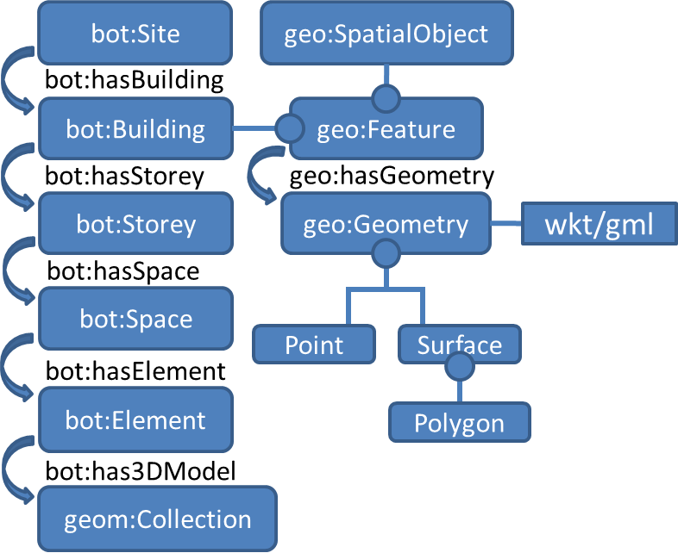
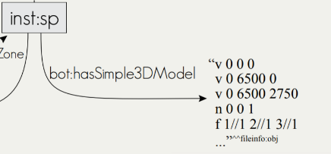
LINKING geospatial & GEOMETRY TO BOT
1
For Simple geolocation
bot:hasZeroPoint links to wsg84:Point
For 2D geospatial data
bot:Building is a subclass of geo:Feature, and can have geometry, which can be expressed as GeoSPARQL WKT.
For 3D geometry
bot:hasSimple3DModel links to a literal that encodes 3D geometry (e.g., OBJ model) bot:has3DModel links to a blank node or IRI that further describes the 3D geometry with another vocabulary (e.g., the Geom ontology - http://rdf.bg/geometry.ttl )

Slide 27
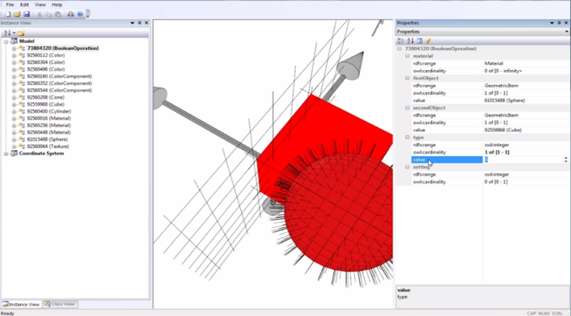
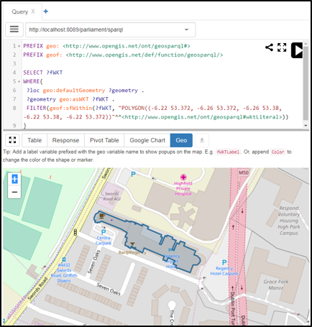
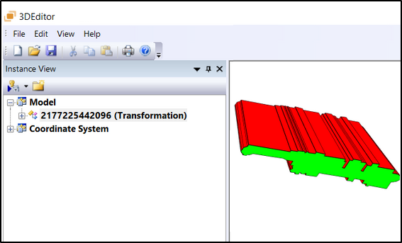
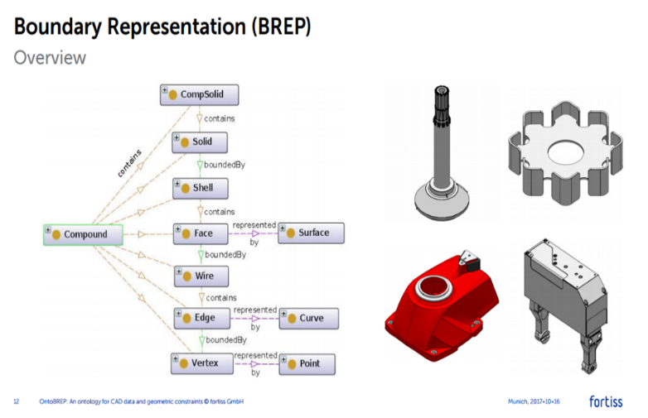
External ontologies for 2D & 3D geometry
1
Geom – 2.5D & 3D
OntoBREP
- 3D
GeoSPARQL – 2D Geospatial

Slide 28
LIAISONS
Looking for collaborations and integration outside our group

Slide 29
Links to other W3C groups
1
W3C
Interest Groups
Working Groups
Community Groups
Dataset Exchange
Web of Things
Spatial Data on the Web
Automotive
(V2Building?)
Data Exchange
Web of Things
Schema.org
Blockchain
Automotive ontology
Notes:
https://www.w3.org/2017/12/odi-study/#rdf
CSVW - https://www.w3.org/community/csvw/
Devices and Sensors WG
https://www.w3.org/das/roadmap
Web of Things
WoT & OGC Sensorthings API
JSON-LD
Spatial Data on the Web IG
CityJSON
CovJSON
SSN extensions
SSN / SOSA
Web of Things IG
1

Slide 30







Links to existing Standardisation Groups
1
ISO/DIS 21597 Information Container for Data Drop
ISO/DIS 23262 GIS and BIM interoperability
buildingSmart Data Dictionary (bSDD)
Linked Data Working Group (LDWG)
CEN TC 442 Building Information Modelling – WG4 Support Data Dictionaries
ETSI – Smart Appliances Reference ontology (SAREF)
American Society of Heating, Refrigerating and Air-Conditioning Engineers BRICK - http://brickschema.org
Dictionary of properties
French national plan for buildings’ digital transition
Notes:
four of the main developers of SAREF are members of LBD-CG
<Foliennummer>

Slide 31
Implementations and Tools
What our community members built

Slide 32
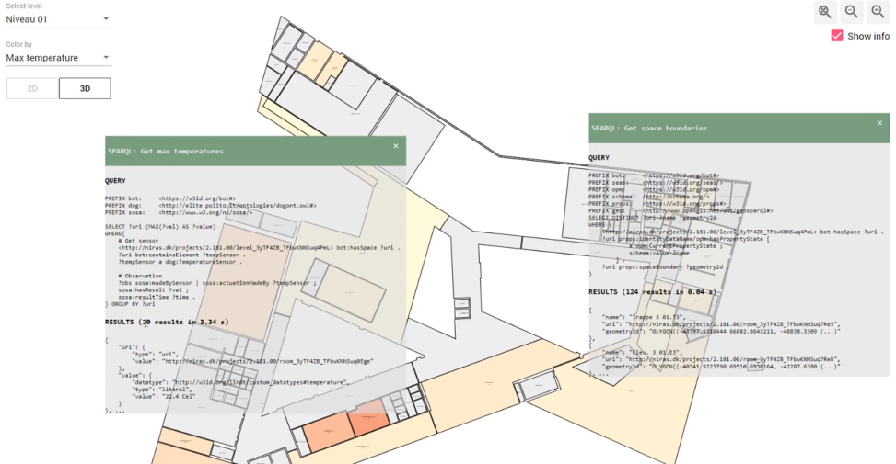
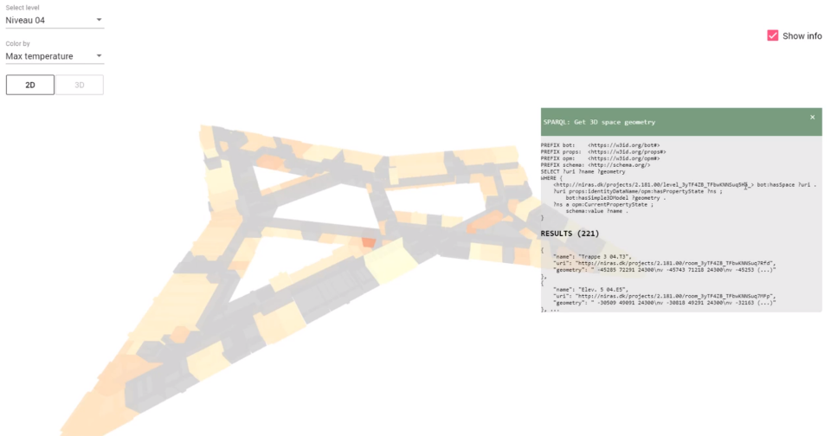
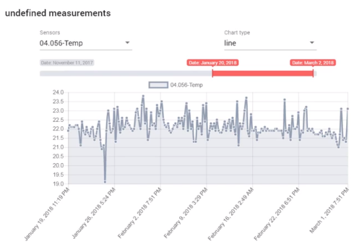
BOT + SOSA + geometry
1
https://youtu.be/P_38gIvrbmg

Slide 33
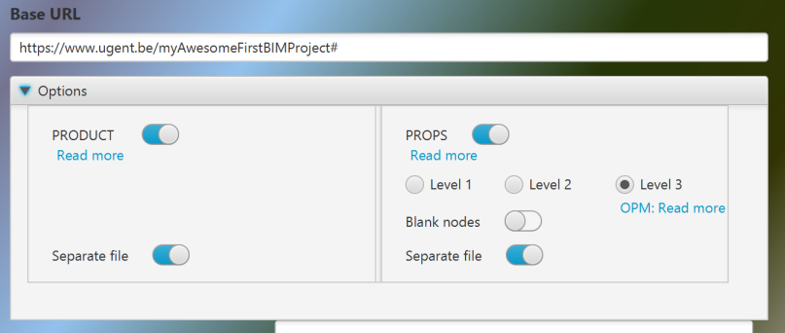
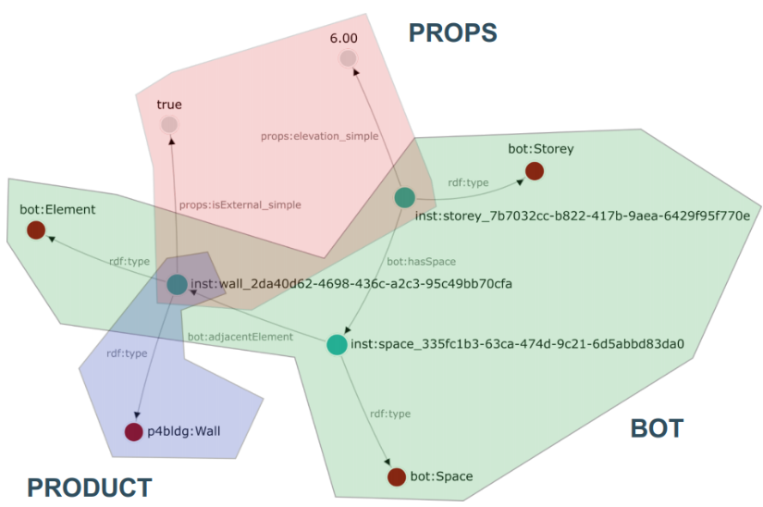
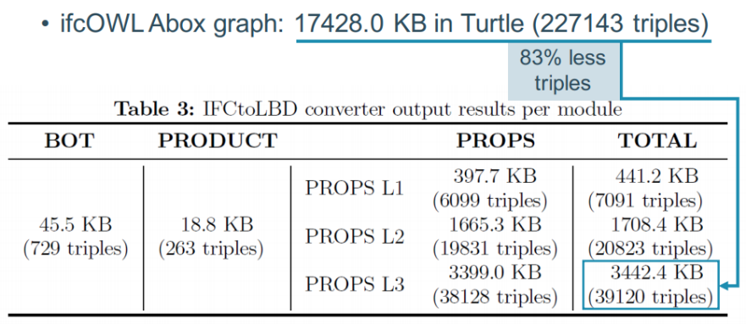
IFCtoLBD converter
1
https://github.com/jyrkioraskari/IFCtoLBD

Slide 34
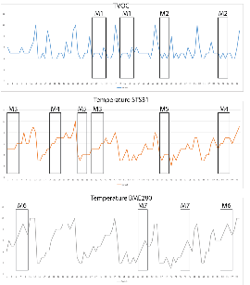
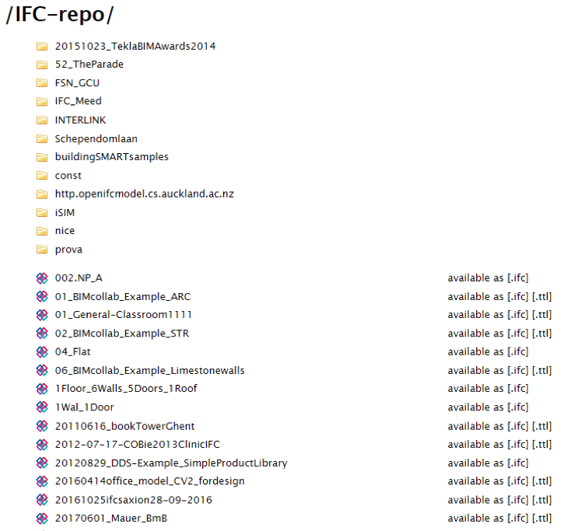
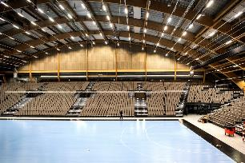

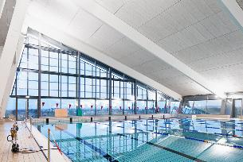
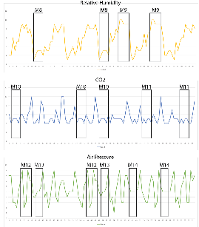

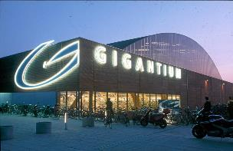
IMPLEMENTATION @GiGANTIUM DENMARK - Combination with sensor data
1
Repo of 531 LBD building graphs
36 million triples in total
372 bot:Building instances
3,523 bot:Zone instances
2,117 bot:Space instances
615,452 bot:Element instances
converted from http://smartlab1.elis.ugent.be:8889/IFC-repo/
to LBD using https://github.com/jyrkioraskari/IFCtoLBD

Slide 35
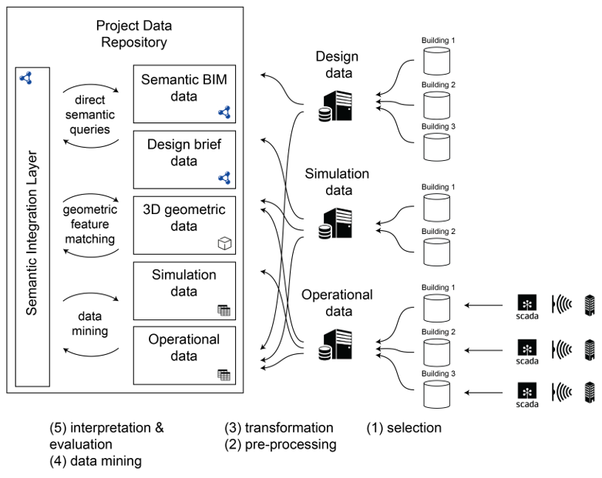
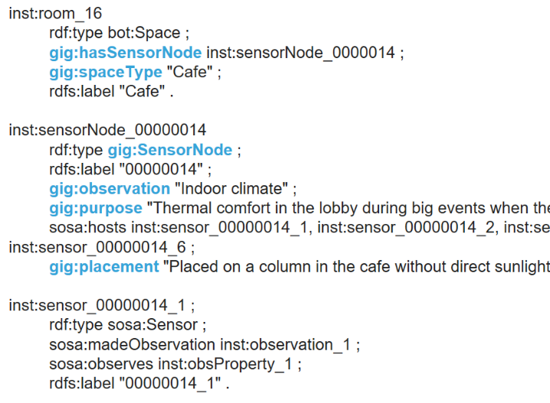
IMPLEMENTATION @GiGANTIUM DENMARK - Combination with sensor data
1

Slide 36
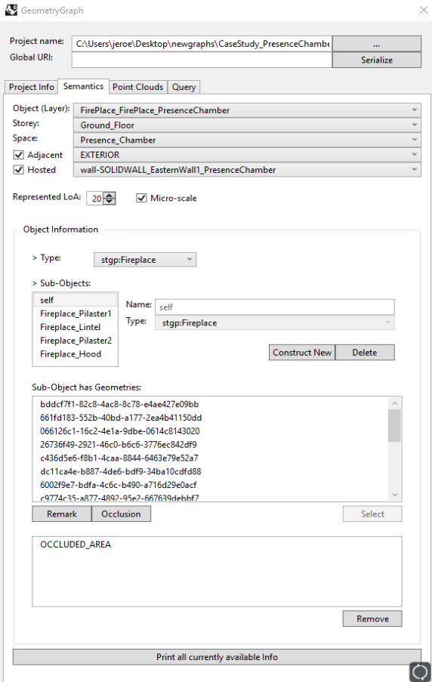
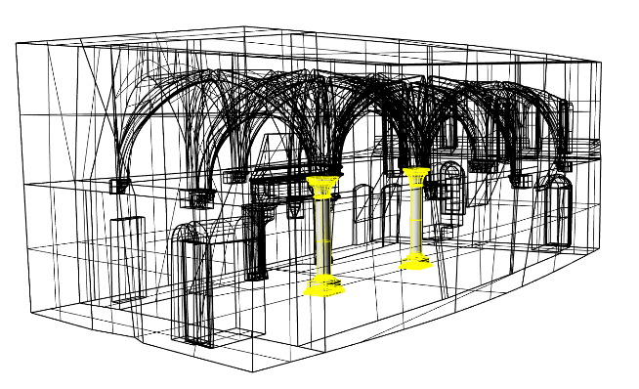
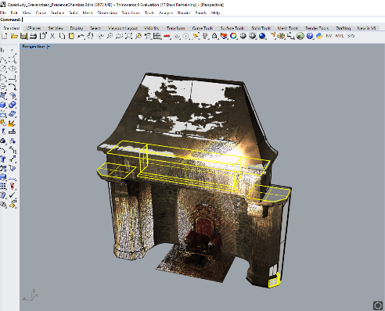
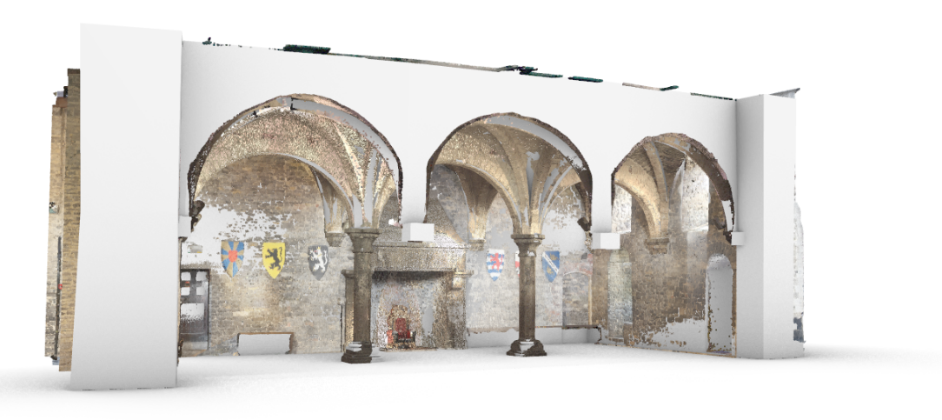
Scan to LBD Graph
1

Slide 37
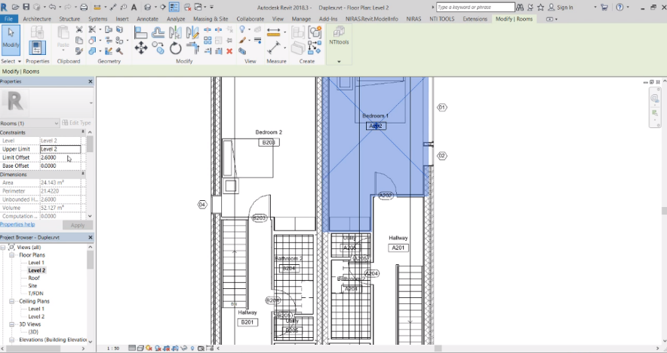
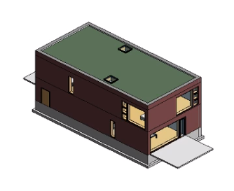
IMPLEMENTATION AT NIRAS using OPM
1
Open Duplex house in Revit
Use exporter to export it to our server
Use web-viewer to show geometry + properties
Change a property in Revit to demonstrate that only the difference is stored
https://www.youtube.com/watch?v=lWoWjM-xCvY

Slide 38
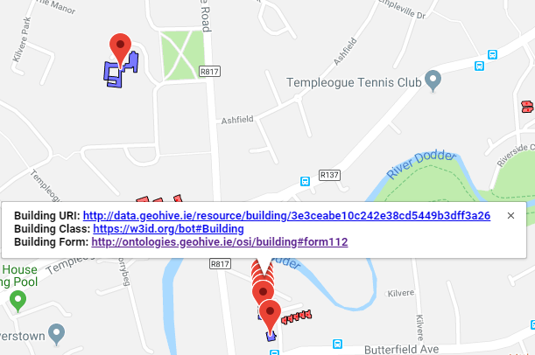
Live Demos: BOT with Added Geospatial
1
Using BOT to interlink Ordinace Survey Ireland building data (>3.5 million buildings)
Provide a registry of authoratative URI’s for Irish building stock.
http://geovis.adaptcentre.ie/
Username: odef_adapt
Password: geo123
https://www.scss.tcd.ie/~mcglink/video/tutorial/geovis/geovis.html

Slide 39
WHERE WE ARE HEADING AT?
Community as a platform and forum to gather experts and interested persons
→ Spin-off working group ? Join other work groups?
Pushing items to existing groups ?

Slide 40
Thank you !

